Slide 1
SE 2101 Software Engineering
Chapter 3
Software Engineering, A Practitioner’s Approach, Pressman R. S.& Maxim B. R., 7th Edition, McGraw-Hill, 2015.

Slide 2
Recap
Agile Models
  XP Programming

Slide 3
Today’s Agenda
Agile Models
  Scrum

Slide 4
Agile process models
Extreme Programming (XP)
Scrum

Slide 5
Scrum
Emphasizes use of a set of software patterns
  Backlog
  Sprints
  Scrum meetings

Slide 6
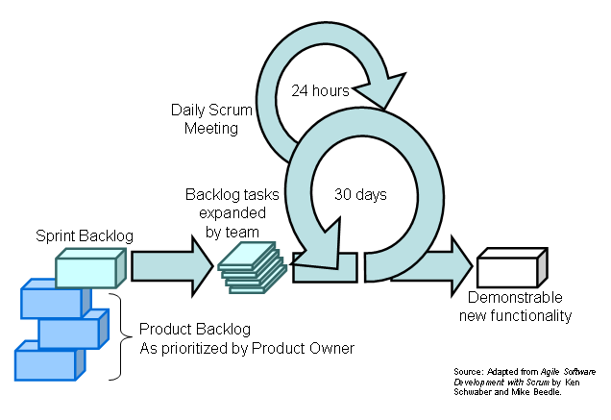
Scrum

Slide 7
Scrum’s Roles
The Product Owner
The Scrum Master
The Team
Everyone else is not part of Scrum

Slide 8
Scrum’s Practices
The Sprint Planning Meeting
The Sprint Review Meeting
The Daily Scrum
The Sprint Retrospective
Everything else is not part of Scrum

Slide 9
The Sprint Planning Meeting
Product Owner describes highest priority features to the Team.
Team decides what they can commit to delivering in the Sprint.
Notes:
Nobody else can offer unwanted advice: everyone else

Slide 10
The Sprint Review Meeting
Time boxed to one hour of prep and four hours of meeting.
Team demonstrates product increment to product owner’s satisfaction.
Informality is encouraged. PowerPoint is discouraged.

Slide 11
The Daily Scrum
Time boxed to fifteen minutes!
The Team and the Scrum Master only.
What have you accomplished since yesterday?
Are your Sprint Backlog estimates accurate?
What are you working on today?
Is there anything blocking you?

Slide 12
The Sprint Retrospective
Time boxed to three hours.
Team, Scrum Master, and (optionally) Product Owner review the last Sprint
What went well?
What can be improved?
Actionable items are presented to the Product Owner.

Slide 13
Scrum’s Artefacts
The Product Backlog
The Sprint Backlog
The Sprint Burndown Chart
The Product Increment
Everything else is not part of Scrum

Slide 14
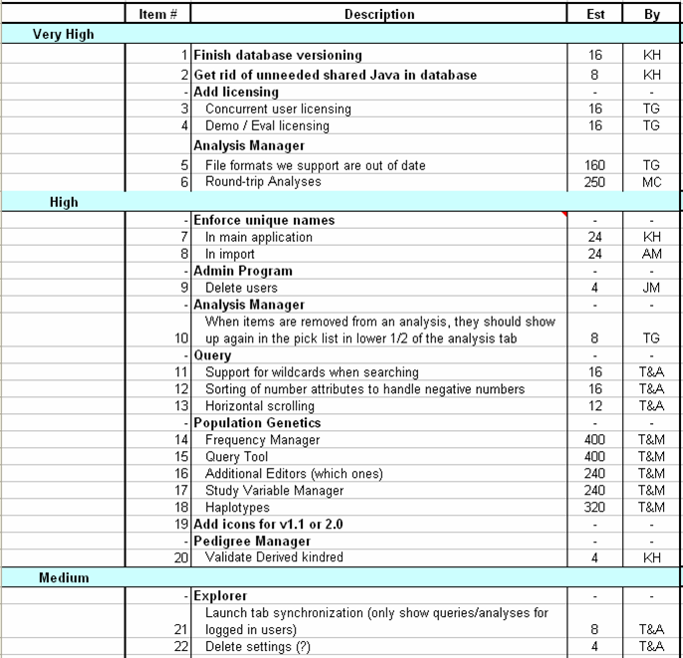
The Product Backlog

Slide 15
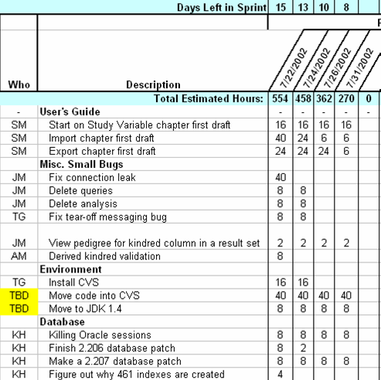
The Sprint Backlog

Slide 16
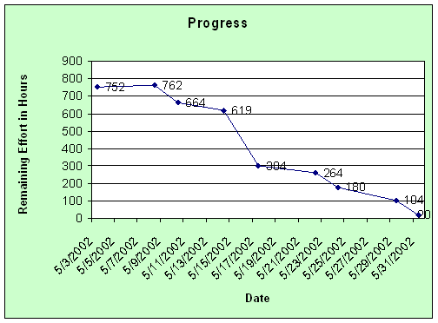
The Sprint Burndown Chart

Slide 17
The Product Increment
Delivers measurable value
“Potentially Shippable”: the process can be halted after every Sprint and there will be some value, some ROI(Return on Investment).
Must be a product, no matter how incomplete
Notes:
Talk about training, QA

Slide 18
Scrum and Agile principles
Customer involvement
Incremental development
People not process
Embrace change
Maintain simplicity

Slide 19
Scrum Vs XP
Scrum | XP
Sprint | Increments
Product Backlog | User Stories
30 days | 15 days
Daily scrum | Pair programming
Notes:
Feature Scrum 🏆 Extreme Programming (XP) ⚡
Focus Process management & project structure Engineering practices & coding discipline
Iteration Length 1-4 weeks (Sprint) 1-2 weeks (Shorter cycles)
Planning Approach Sprint Planning (fixed scope for the sprint) Continuous planning, can change requirements mid-iteration
Roles Scrum Master, Product Owner, Development Team No strict roles, just a customer, coach, and developers
Customer Involvement Customer interacts mainly with the Product Owner Customer works closely with the development team daily
Development Practices No strict coding practices, focuses on process Test-Driven Development (TDD), Pair Programming, Continuous Integration
Change Management Scope is fixed within a sprint Can adapt to changes even within an iteration
Meetings Daily Standups, Sprint Planning, Sprint Review, Sprint Retrospective Standups, Iteration Planning, Continuous Feedback
Quality Assurance Encourages testing but doesn’t enforce specific techniques Heavy focus on automated testing, code refactoring, and continuous feedback
Best Suited For Teams that need structured, iterative development Teams that require high adaptability and strong coding discipline

Slide 20
Summary
Agility principles
XP
Scrum

Slide 21
The End.

